Slide 1

Agile Software Development
Workflow Stream
SoftUni Team
Technical Trainers
Software University
http://softuni.bg

Slide 2
Table of Contents
Homework & Questions
Backlog Grooming
Team Capacity
Priorities based on Client’s needs
Defining the right size
Measurements in Agile
Velocity
Team Morale
Quality
Customer Satisfaction

Slide 3
Have a Question?
sli.do #Agile-2021

Slide 4

Homework
Questions?

Slide 5
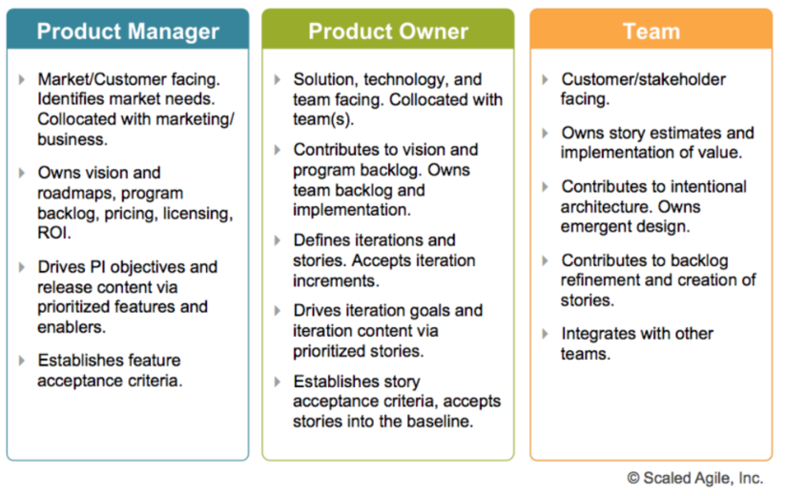
Open questions
Product Owner is a role you play on a Scrum team. Product Manager is the job.

Slide 6
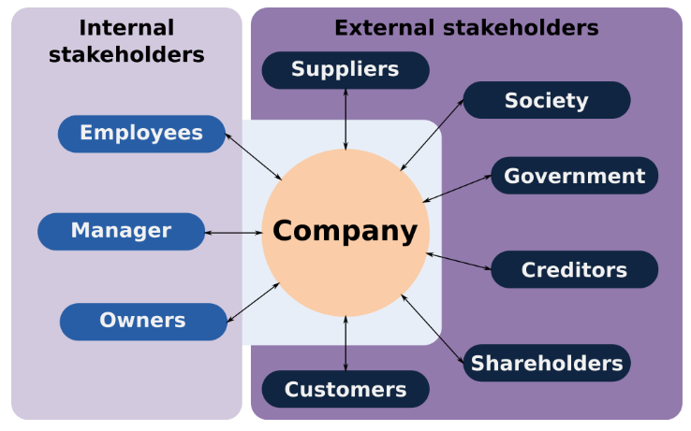
Open Questions
Who are the stakeholders in a project?

Slide 7
Open Questions
Stakeholders, some examples:
Internal – work for the organization – finance, HR, management and strategists, owner/s, etc.
External – usually customers, or other parties which might be influenced by the project, but reside outside the organization.
External suppliers – marketing, headhunting agencies, other providers related to the project.
Government?
Shareholders.

Slide 8

Backlog Grooming

Slide 9

Backlog Refinement

Slide 10
Backlog Grooming / Refinement
Main goal – to ensure that the product backlog is current and complete.
The activities done during the process:
Defining the team capacity
Defining the priorities
Defining the size of different User Stories
Adding the Acceptance Criteria
Defining the DoD
Keep in mind that the Backlog can and will change during the project completion

Slide 11
Define the team capacity?
Use a simple formula:
5 employees, full time
Iteration which goes for 2 weeks
8 hours a day
5 (employees) x 8 (hours) x 10 (days) = 400 hours
Is this a good formula?

Slide 12
How to define the team capacity?
A better approach – 80/20
5 employees, full time.
Iteration which goes for 2 weeks.
8 hours a day.
5 (employees) x 6 (hours) x 10 (days) = 300 hours

Slide 13
How to define the team capacity?
Define the team capacity.
How many team members are available?
Is everyone working full time on the project?
Consider public holidays, attrition, newcomers Vs seniors, what else?
Consider the rule 80/20
Do not overcomplicate but try to be realistic
Change if required till you find the right proportion

Slide 14
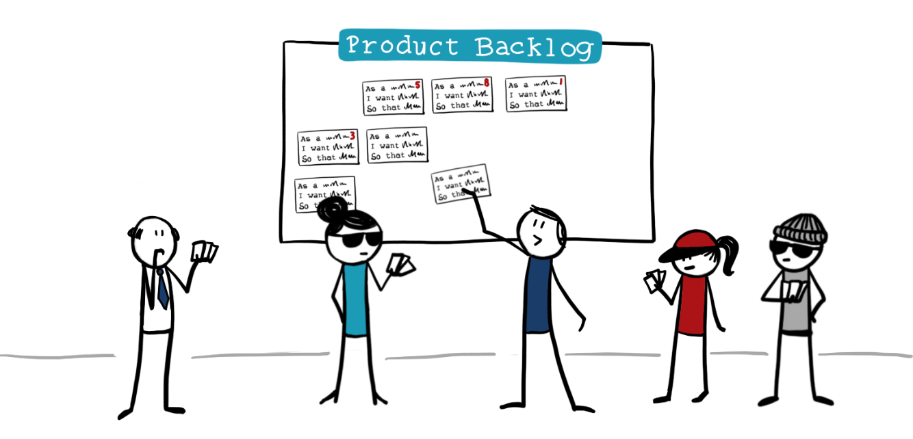
Defining the priorities from Client’s perspective

Slide 15
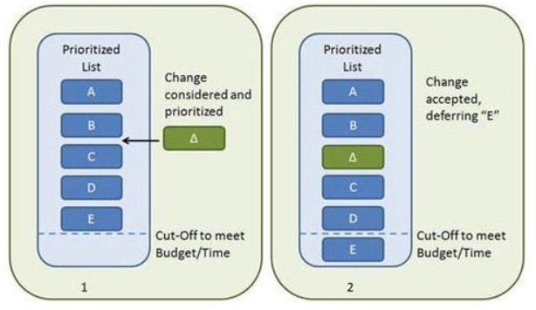
Customer Value-based Prioritization
Simple Schemes:
Using priorities (low to high) defining the level of importance.
Use a simple priority chart
High, medium, low.
1, 2, 3…etc.
Organize vertical – high to low priority.
Define each level of severity.

Slide 16
Sizing the User Stories?
Simple point system is always a good approach.
Points might represent hours, such as:
1 point = 1 to 3 hours
2 points = 3 to 5 hours
…etc
Think if more than one person must or can work on a single item
Try not to fragment too much
It is OK not to have the right size from the first try

Slide 17
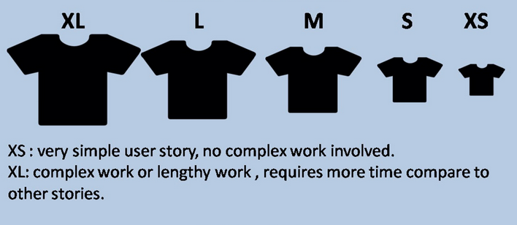
Sizing the User Stories?
You can use different approach – as an example a T-shirt size – “small”, “medium”, “large” and “X-large”, as “X-large” is an Epic.
An advantage of T-shirt size is the fact that everyone can recognize the different sizes.

Slide 18
How to size the User Stories?
So, once we agree on what system which would be used to measure the User Stories, how do we agree on the size of the specific item?
The PO would introduce the User Story/s
Team would agree on appropriate size
Approach first the stories where a consensus could be easily met
Discuss those items which would introduce more discussions
Keep it short and avoid unnecessary discussions

Slide 19
Backlog Grooming
It helps the team to organize the work
Used as a source for documentation
Well defined Backlog helps the team to foresee the project completion, structuring its work better
It is OK to change the Backlog after an iteration
It is OK to change sizes and priorities but be careful with too many changes

Slide 20
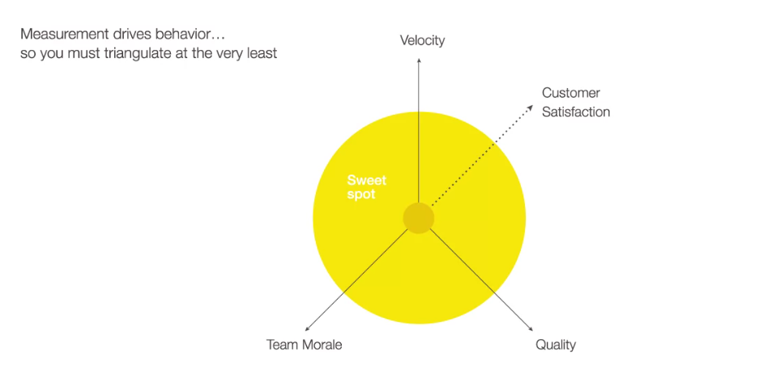
Measuring, Reporting and Tools

Slide 21
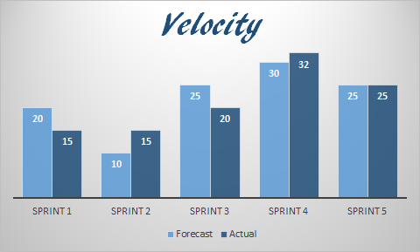
Team Velocity
Measures the speed of the Agile team
Completed after each iteration
Based on the number of User Stories completed, but most important, on the total number of points completed in an iteration

Slide 22
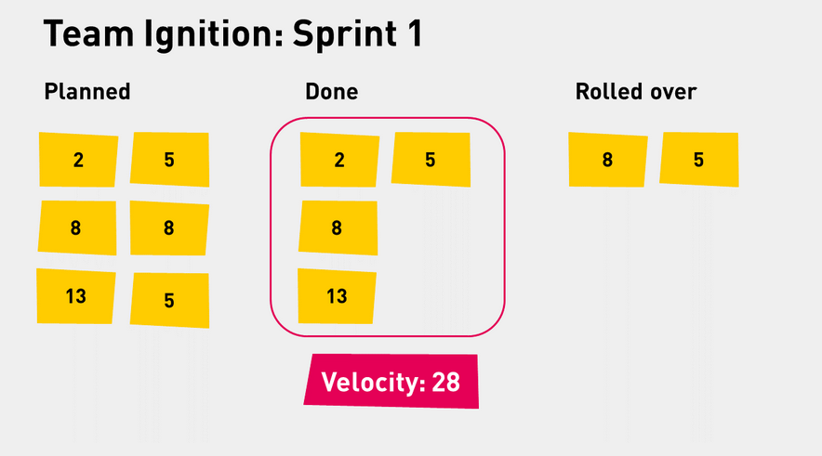
Team Velocity – how does it work?
After Sprint /iteration/ 1

Slide 23
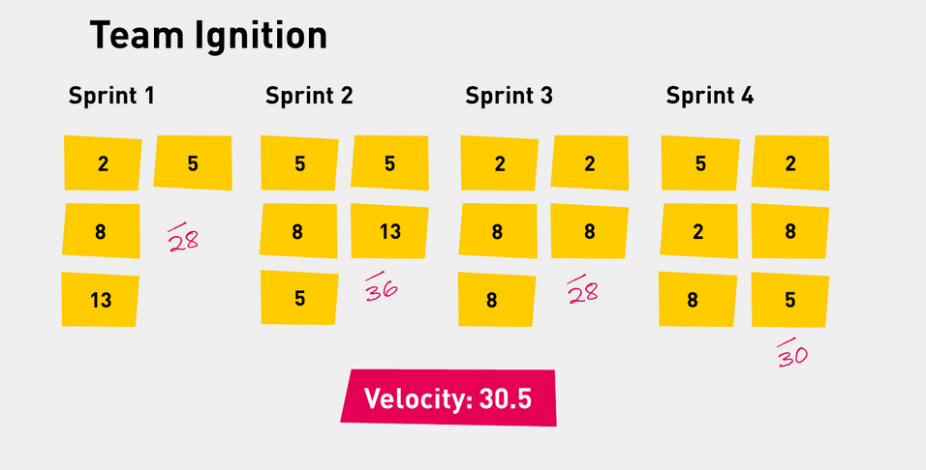
Team Velocity
After Project completion

Slide 24
Team Velocity
Can you think of a reason why the Team Velocity should not be the only measurement?
Could you think how Velocity can help the project?
What other charts could visualize the Velocity?

Slide 25
Team Velocity
Can you think of a reason why the Team Velocity should not be the only measurement?
Team might be tempted to oversize the story.
Similar stories might be sized differently in the different sprints.
If the team has little experience with certain product, the velocity might not give us the precise comparison.
Could you think how Velocity can help the project?
Help estimate how much work the team would be able to get through in a longer period of time.
It works best in teams which are stable (low attrition).
What other charts could visualize the Velocity?
Burndown/Burnup chart.

Slide 26
Team Morale

Slide 27
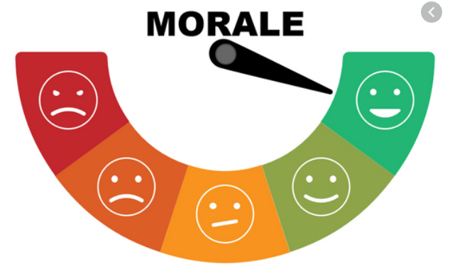
Team Morale
People are the most important aspect in a project/organization
Think of the Agile Manifesto/Principles
So what practices are out there to help us define the morale?

Slide 28
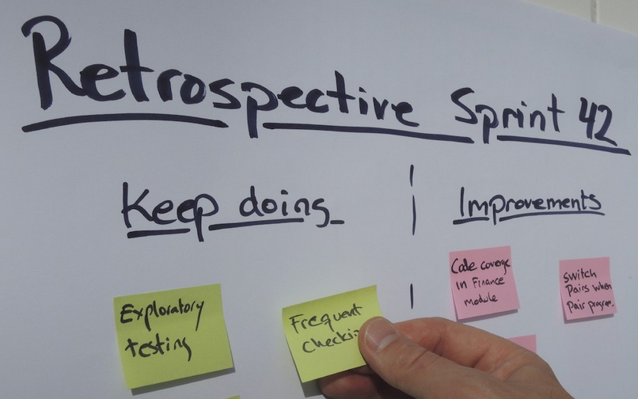
Team Morale

Slide 29

Team Morale
Mood marbles
After each day, the team simply walks and place a marble depending on the mood today
No need for special equipment – could be done with sticky notes
Its quick and efficient
There are also opportunities for distributed teams

Slide 30
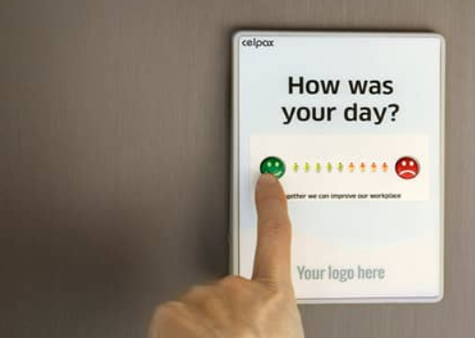
Team Morale
Measure effective
Good to have an overall chart which shows development (or devolving) of the team moral
Don’t overdo it!
There are many creative ways, games, or technologies to help us

Slide 31

Measurements in Agile

Slide 32
Measuring Quality in Agile
There are three main types of agile metrics:
Scrum metrics. The most-commonly used metrics in software development.
Kanban metrics. An agile software / none software development framework similar to Scrum.
Lean metrics. Metrics used to streamline the manufacturing of physical products, from which both Kanban and Scrum originate.

Slide 33

Measuring Quality in Agile
Escaped Defects
Helps to identify the number of bugs in a build or release after it enters production.
In manufacturing, the measurement might focus on number of defects (Lean methodology).
It helps drive down the waste and focus on a better product.

Slide 34
Measuring Quality in Agile
Failed Deployments
Failed deployments can shed light on how reliable and stable are the new deployments.
If the team is building working software at all.
Can use the failed deployments metrics to understand whether a given sprint or release is ready to go to production.
The number should be as close to “0” as possible.
It helps prevent major issues.

Slide 35
Agile Measurements – CS + Quality

Slide 36
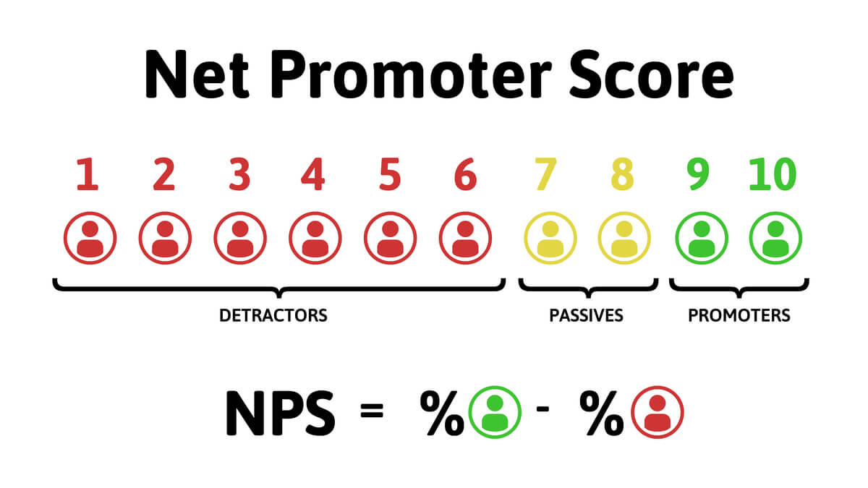
Agile Measurements – CS + Quality

Slide 37
Agile Measurements – CS + Quality
Net Promoter Score (NPS)
It is often executed in the form of a survey
Keep the number of questions to its minimum
Use short, but well targeting questions
Timing in essential

Slide 38

Agile Measurements – CS + Quality
Structured, or semi structured Interview.
Larger intervals – once in a year
Target your audience
Be aware that the technique takes time and effort on both sides
Respect time

Slide 39
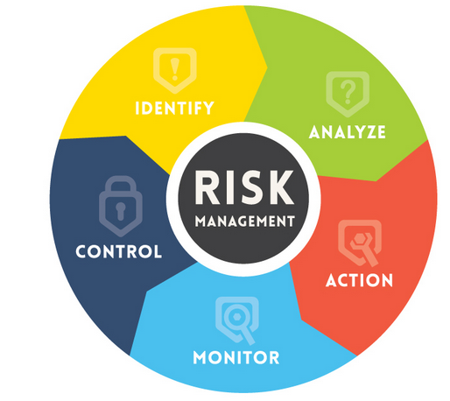
Measuring risk in Agile
Understanding Risk is an important part of any project – Agile, or not
Risks in Agile are no different from other type of projects
So where is the difference?

Slide 40
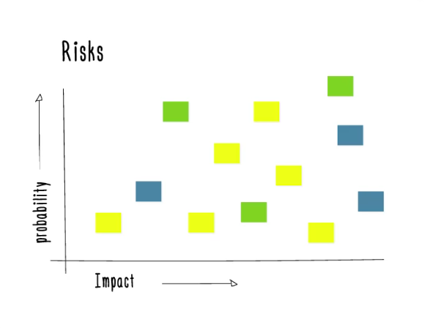
Measuring risk in Agile
In nature, Agile tends to run projects more light-weight
Agile derives from self-sufficient teams, so each team can com with its own structure of how to measure risk
Agile tries to visualize
Everyone is involved
Risk vs Impact is still the main focus
…but there are other ways to visualize risk

Slide 41

Measuring risk in Agile
Place Major Risks in the center. The lesser the risk, the more you would go to the periphery.
Place the risk depending on its area. Typically, there are three types of risks: People, Process, Technological. Financial risk is not for the team.
Do not wait Retrospectives to place the risk. You can do it during, or after a Stand up.

Slide 42

Summary
Defining the User Stories is the key for Customer Success
Organizing the Backlog is the key for Project Success
Even though most responsibilities remain with the PO, or SM, the Agile Team should actively participate in each stage.
Measurements are the only way to generate facts.
Think of all criteria which influence an Agile Project.
Different types of projects might have different requirements.
Think and Iterate.
…
…
…

Slide 44













SoftUni Diamond Partners

Slide 45




SoftUni Organizational Partners

Slide 46





Trainings @ Software University (SoftUni)
Software University – High-Quality Education, Profession and Job for Software Developers
softuni.bg
Software University Foundation
http://softuni.foundation/
Software University @ Facebook
facebook.com/SoftwareUniversity
Software University Forums
forum.softuni.bg

